Slide 1
Error Detection
Bit Error Rate(BER): It is the ratio of number N_{e} of errors appearing over a certain time interval t to the number N_{t} of 1 and 0 pulses transmitted during this interval. BER =
N_{e}/ N_{t} = N_{e} / R*t
Data Link Layer

Slide 2
Types of Error
Single Bit Error: In a single-bit error, only one bit in the data unit has changed
00001100 (sent)
00000100 (rcvd)
Burst Error: A burst error means that 2 or more bits in the data unit have changed
00001100 (sent)
01000100 (rcvd)
Data Link Layer

Slide 3
Error Detection
Redundancy: adding extra bits for detecting errors at the destination.
  Parity Check: a parity bit is added to every data unit so that the total number of 1s is even (or odd for odd-parity).
  Checksum
  Cyclic Redundancy Check (CRC)
Data Link Layer

Slide 4


Parity Checking
Single Bit Parity:
Detect single bit errors
Two Dimensional Bit Parity:
Detect and correct single bit errors
Odd parity
0
0
Data Link Layer
5-<number>

Slide 5
Example 1
Suppose the sender wants to send the word world. What will be:
  Sent data?
  Will data be accepted if received as:
    11101110 11011110 11100100 11011000 11001001
    11100110 11011110 11000100 11011000 11001001
    11101110 11011110 11100100 11011000 11001001
    11111110 11011110 11101100 11011000 11001001
Data Link Layer

Slide 6
Solution
In ASCII the five characters are coded as
1110111 1101111 1110010 1101100 1100100
The following shows the actual bits sent
1101110 11011110 11100100 11011000 1001001
Data will be:
  Accepted
  Not accepted
  Accepted
  Not accepted
Data Link Layer

Slide 7
Note
Simple parity check can detect all single-bit errors. It can detect burst errors only if the total number of errors in each data unit is odd
Data Link Layer

Slide 8
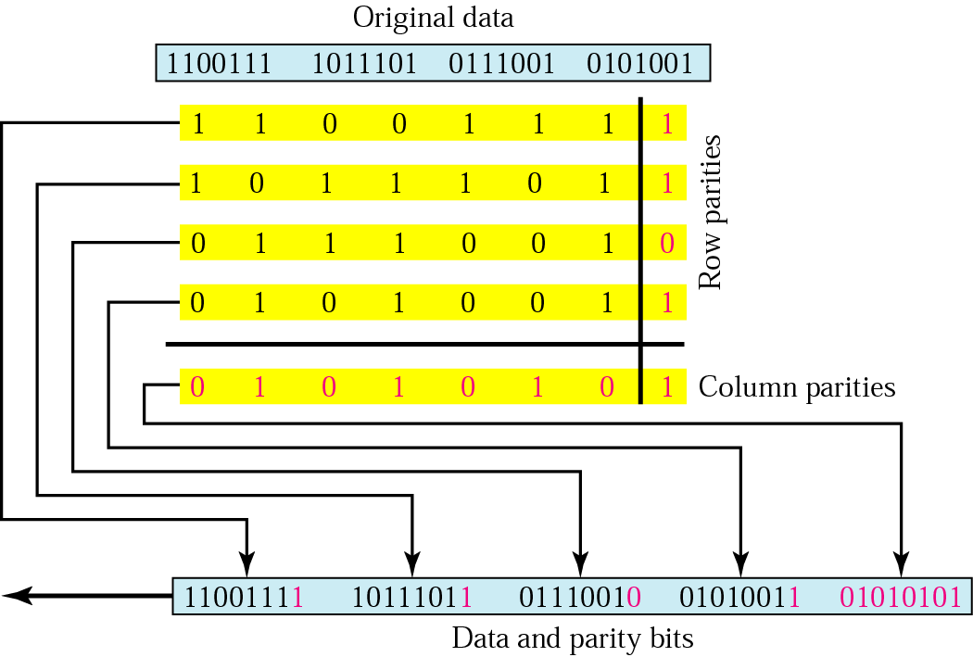
Two-dimensional parity
Even Parity
Data Link Layer

Slide 9

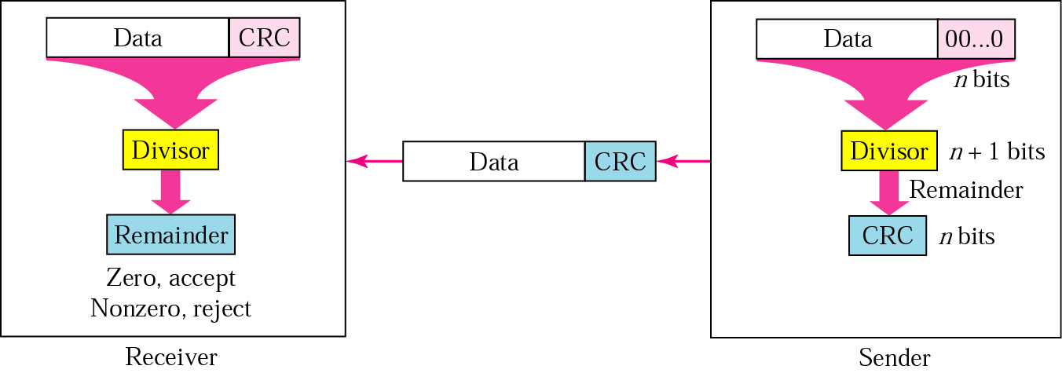
CRC generator and checker
Data Link Layer

Slide 10

CRC Example
Data Link Layer
5-<number>

Slide 11
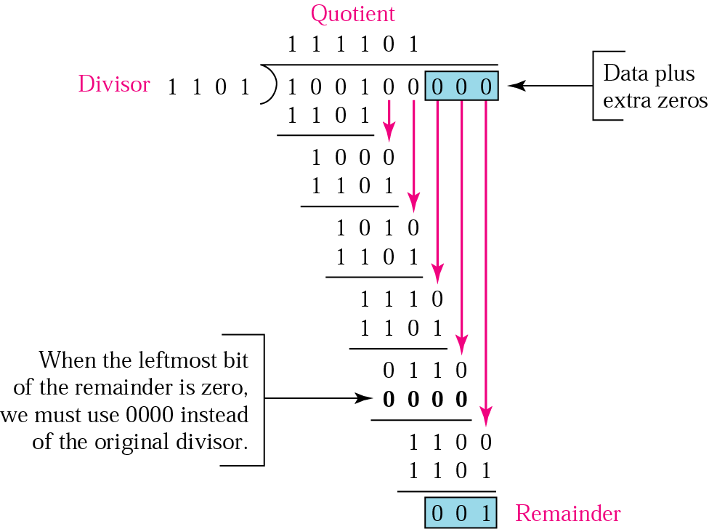
Binary division in a CRC generator
Data Link Layer

Slide 12
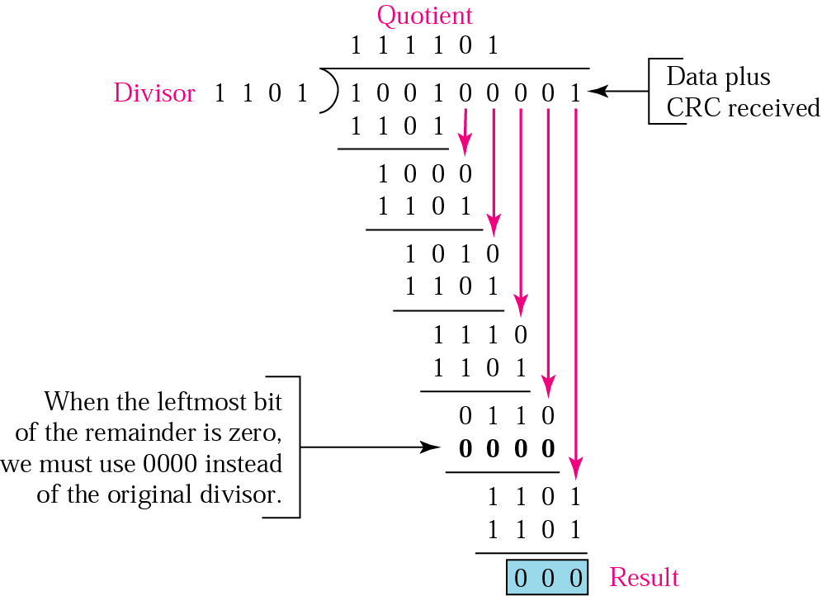
Binary division in CRC checker
Data Link Layer

Slide 13
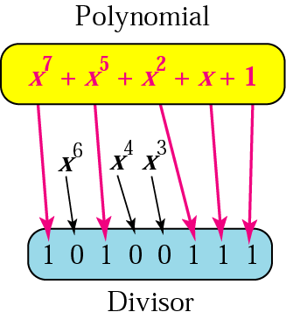
A polynomial representing a divisor
Data Link Layer

Slide 14
Example 5
Polynomial Properties(Divisor):
1. It should not be divisible by x
2. It should be divisible by x+1
It is obvious that we cannot choose x (binary 10) or x² + x (binary 110) as the polynomial because both are divisible by x. However, we can choose x + 1 (binary 11) because it is not divisible by x, but is divisible by x + 1. We can also choose x² + 1 (binary 101) because it is divisible by x + 1 (binary division).
Data Link Layer

Slide 15
Example 6
The CRC-12
x¹² + x¹¹ + x³ + x + 1
which has a degree of 12, will detect all burst errors with a length less than or equal to 12, and will detect, 99.97 percent of the time, burst errors with a length of 13 or more.
Data Link Layer

Slide 16

Internet Checksum
Note:
The sender follows these steps:
The unit is divided into k sections, each of n bits.
All sections are added using one’s complement to get the sum.
The sum is complemented and becomes the checksum.
The checksum is sent with the data.
Data Link Layer

Slide 17
Internet Checksum
Note:
The receiver follows these steps:
The unit is divided into k sections, each of n bits.
All sections are added using one’s complement to get the sum.
The sum is complemented.
If the result is zero, the data are accepted: otherwise, rejected.
Data Link Layer

Slide 18
Example 7
Suppose the following block of 16 bits is to be sent using a checksum of 8 bits.
10101001 00111001
The numbers are added using one’s complement
10101001
00111001
------------
Sum 11100010
Checksum 00011101
The pattern sent is 10101001 00111001 00011101
Data Link Layer

Slide 19
Example 8
Now suppose the receiver receives the pattern sent in Example 7 and there is no error.
10101001 00111001 00011101
When the receiver adds the three sections, it will get all 1s, which, after complementing, is all 0s and shows that there is no error.
10101001
00111001
00011101
Sum 1 1 111111
Complement 00000000 means that the pattern is OK.
Data Link Layer

Slide 20
Example 9
Now suppose there is a burst error of length 5 that affects 4 bits.
10101111 11111001 00011101
When the receiver adds the three sections, it gets
101 0 1 1 1 1
11 1 1 1 001
00 0 1 1101
Partial Sum 1 1 1 000101
Carry 1
Sum 11000110
Complement 00111001 the pattern is corrupted.

Slide 21
Error Correction
Retransmission
Forward Error Correction(FEC)
Burst Error Correction
Data Link Layer

Slide 22
Table 10.2 Data and redundancy bits
Number of data bits m | Number of redundancy bits r | Total bits m + r
1 | 2 | 3
2 | 3 | 5
3 | 3 | 6
4 | 3 | 7
5 | 4 | 9
6 | 4 | 10
7 | 4 | 11
Data Link Layer

Slide 23
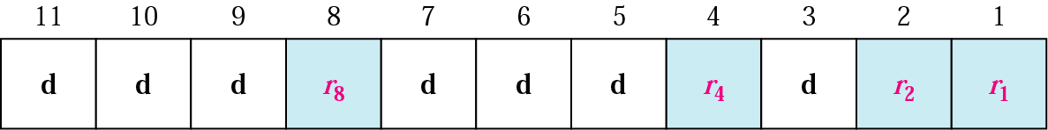
FEC
Positions of redundancy bits in Hamming code
Each r bit is the parity bit for one combination of data bits
Data Link Layer

Slide 24
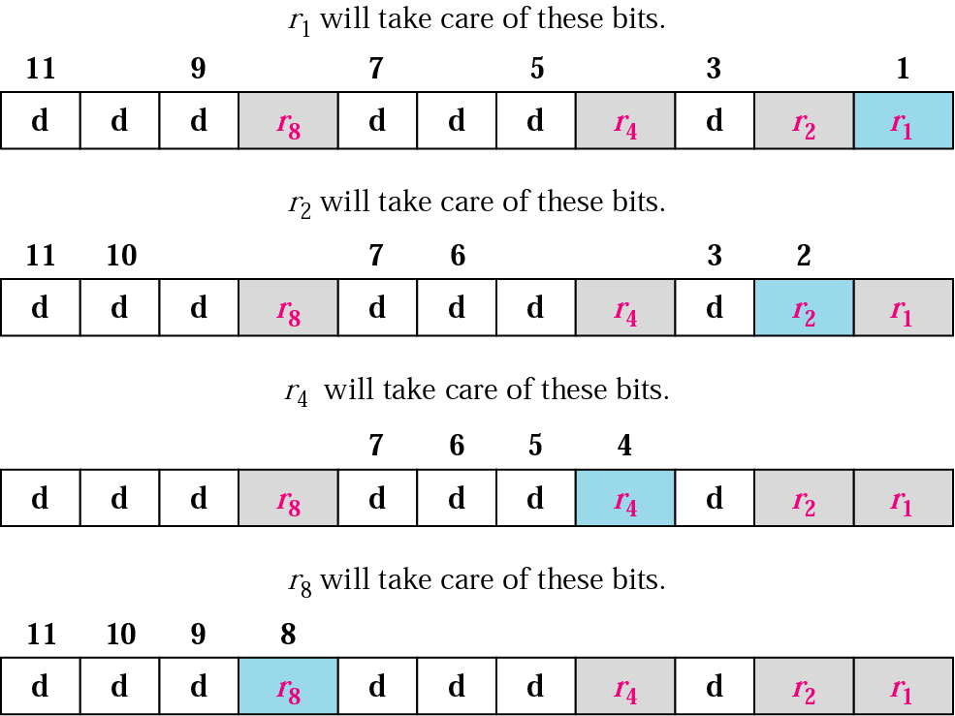
Redundancy bits calculation
Data Link Layer

Slide 25
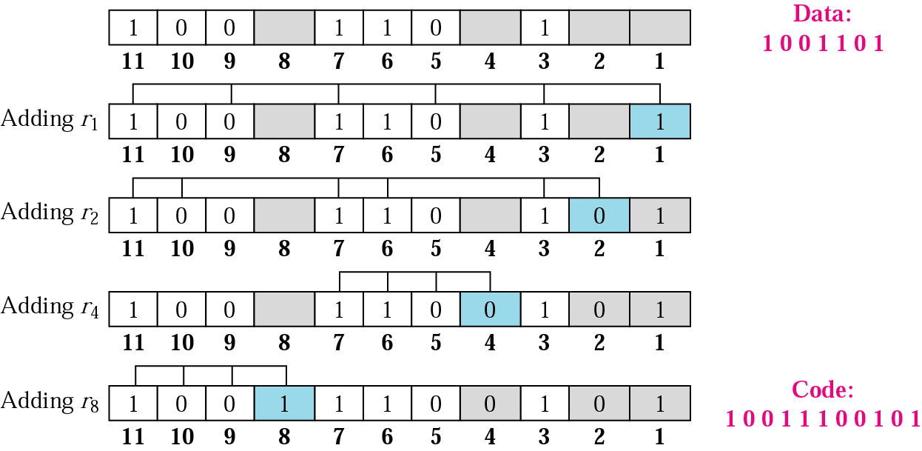
Data Link Layer

Slide 26
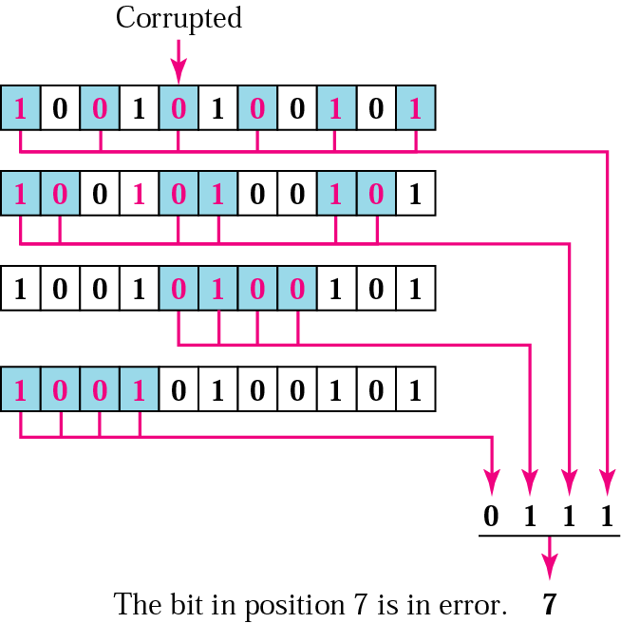
10.17 Error detection using Hamming code
Data Link Layer

Slide 27
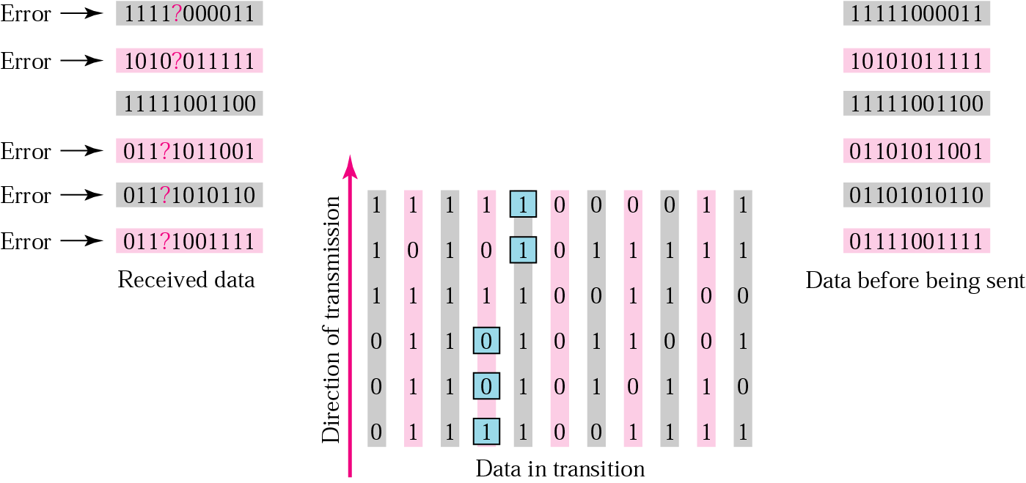
10.18 Burst error correction example
Data Link Layer

